Slide 1
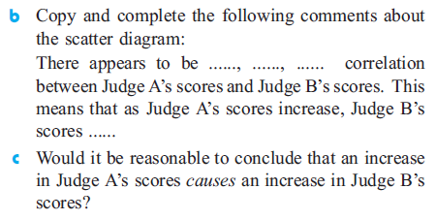
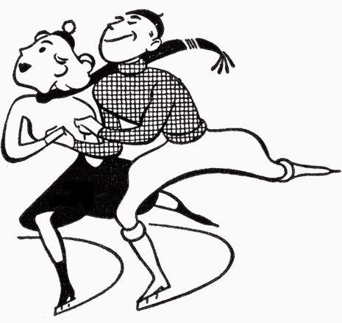

Slide 2
Learning intentions:
Today I will learn to…
Define and use Pearson’s correlation coefficient
Success Criteria:
I will know I am successful when I can…
Approaches to Learning:
Communication Skills

Slide 3
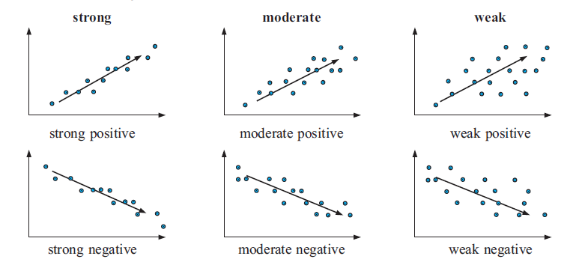
In the previous lesson, we began to classify the strength of the correlation between two variables as strong, moderate, or weak.

Slide 4
The sign of r indicates the direction of the correlation.
The size of r indicates the strength of the correlation.

Slide 5
