Slide 1
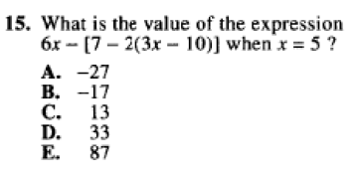
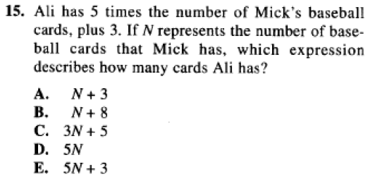
4BC Solving Linear Equations
BELL RINGER:
ACT CCRS
A 403. Solve routine first-degree equations

Slide 2
DEF – Linear equations are of the form ax + b = d, where x is a variable, and a, b, and d are constants.
Solving Methods
Undo tables
Balancing

Slide 3
Undo Tables only work when the variable appears in on location!
Involve mapping out the Order of Operations as they occur to the unknown.
OofO | Inverses
X | = | 4
·2 | /2 | 8
-3 | +3 | 5

Slide 4
Balancing works well all the time, but is especially helpful when the variable is appearing on both sides of the equation.
$$2x+15=8x−9$$
Balancing is a process of making 0’s and 1’s until we are left with a solution.
Remember: To keep things balanced, whatever we do to one side we must also do to the other.

Slide 5
What about when the variable appears more than once?
Then combine like terms (x’s with x’s, constants with constants)
$$5x+26=16$$
Then we are right back to our original solving methods.
$$8x+20−3x+6=16$$

Slide 6
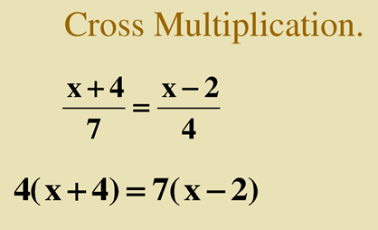
Some equations may have fractions, but we can make these look like linear equations by ‘cross multiplying.’
Now we are back to something that looks familiar and requires some distribution!

