Slide 1
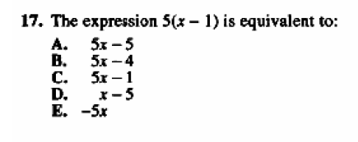
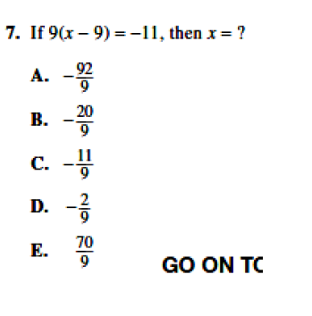
4E Problem Solving with Linear Equations
ACT CCRS:
AF 502. Build functions and write expressions, equations, or inequalities with a single variable for common pre-algebra settings (e.g., rate and distance problems and problems that can be solved by using proportions)

Slide 2
4E Learning Intentions - Today, I am going to:
Decode verbal models and use linear equations to solve problems.
As mentioned last section, the whole purpose of solving linear equations is that many problems can be translated into linear equations.
Recall that linear equations are of the form ax + b = d, where x is a variable, and a, b, and d are constants.

Slide 3
Problem Solving Plan (PSP):
Read the problem carefully.
Determine how many variables you need and what the variable(s) means in the situation.
Write equation(s) that represent the problem.
Solve the equation.
Answer the question. Make sure your answer makes sense.

Slide 4
Problem Solving Plan (PSP):
Read the problem carefully.
Determine how many variables you need and what the variable(s) means in the situation.
Write equation(s) that represent the problem.
Solve the equation.
Answer the question. Make sure your answer makes sense.

Slide 5
Problem Solving Plan (PSP):
Read the problem carefully.
Determine how many variables you need and what the variable(s) means in the situation.
Write equation(s) that represent the problem.
Solve the equation.
Answer the question. Make sure your answer makes sense.

