Slide 1
LAUNCH
Chapter 4 – Equations and Formulae
Section G.2 – Simultaneous Equations Again
4G2 Learning Intentions - Today, I am going to:
Solve simultaneous equations by elimination.
Recognize when to use substitution versus elimination.

Slide 2
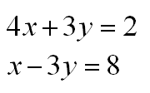
Bell Ringer ACT CCRS: A 604. Solve systems of two linear
equations
Please solve the following system for the simultaneous solution using substitution method
Although that wasn’t too bad, this is a perfect situation for a another method.
Let’s look closer…

Slide 3
EXPLORE
L.I.#2 – Recognize when to use substitution vs elimination.
Example 1A.
Notice that the coefficients on the y-terms are opposites...
Let’s use elimination…
DEF – The elimination method is best used when neither equation has a subject. (Ax + By = C)

Slide 4
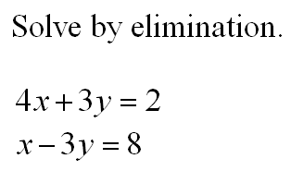
EXPLORE
L.I.#1 – Solve simultaneous equations by elimination.
Example 1B.
Quick steps to elimination:
Line up the x, y, and constant terms vertically.
Create opposite coefficients on one of the variables.
Add vertically to eliminate one of the variables. Solve for the other variable.
Substitute backwards to find the other variable.
Check your solution quickly.

Slide 5
EXPLORE
L.I.#1 – Solve simultaneous equations by elimination.
Example 2.
Quick steps to elimination:
Line up the x, y, and constant terms vertically.
Create opposite coefficients on one of the variables.
Add vertically to eliminate one of the variables. Solve for the other variable.
Substitute backwards to find the other variable.
Check your solution quickly.

Slide 6
EXPLORE
L.I.#1 – Solve simultaneous equations by elimination.
Example 3.
(OYO)
Quick steps to elimination:
Line up the x, y, and constant terms vertically.
Create opposite coefficients on one of the variables.
Add vertically to eliminate one of the variables. Solve for the other variable.
Substitute backwards to find the other variable.
Check your solution quickly.

