Slide 1
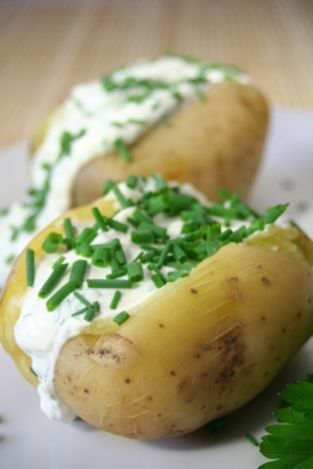
4H Simultaneous Equations by Substitution
Paul and Suzanne are peeling potatoes for their families Christmas Eve dinner. Each has their own bag. Paul starts off with 32 potatoes in his bag and Suzanne starts with 40. Paul peels 2 potatoes/min and Suzanne can peel 3 potatoes/min.
Please complete the following table for this situation
Write a linear equation in intercept form for both people.
When will they have the same amount of potatoes left to peel?
Time (min) | Paul’s Potatoes | Suzanne’s Potatoes
0
1
2
3
4

Slide 2
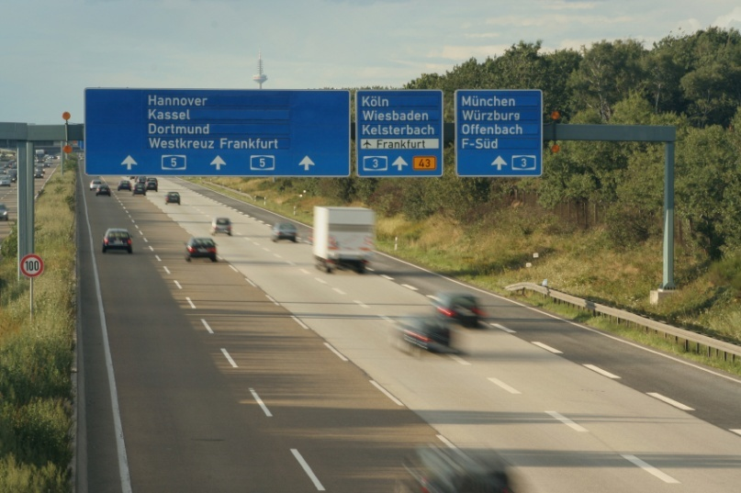
4H Simultaneous Equations by Substitution
Solving systems of equations can of course be done symbolically (using just the equations) as well as graphically.
The substitution method works on the same principal of substitution we have used in previous sections. If we know what 1 variable is equal to, we can put that equality in it’s place.
Lets look at the following system representing the distance between two cars over a period of time on an interstate.

Slide 3
4H Simultaneous Equations by Substitution
Solve each system of equations by substitution, and check your solution.

