Slide 1
The box plot shows the five-number summary of the points scored by a college women's basketball team throughout their 45 game season.
What is the median of the data set?
What is the upper quartile for the data set?
In approximately how many games did they score less than 53 points?
Is the mean for this data set less or more than the median?

Slide 2
Learning Intentions:
Today I will learn to…
find probabilities for normal distributions, with and without technology.
Success Criteria:
I will know I am successful when I can…
efficiently solve problems involving normal distributions with technology and without technology.
Approaches to Learning:
Thinking Skills
Communication Skills

Slide 3
Terms and notation
Normal Distribution:
What percent of the data lies within 1 standard deviation of the mean?
…2 standard deviations of the mean?
…3 standard deviations of the mean?

Slide 4
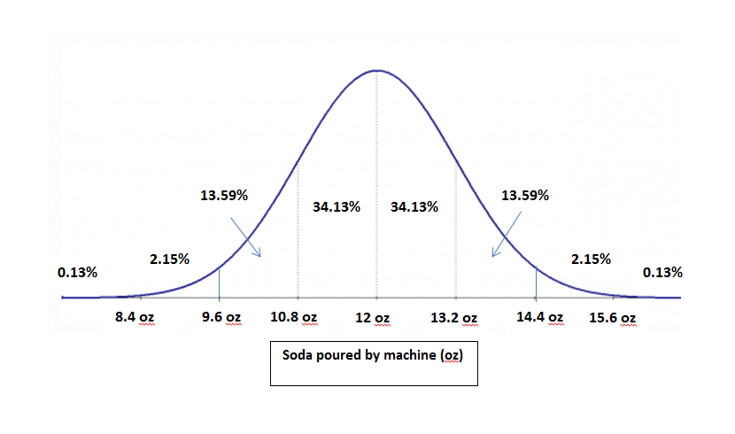
Most fast food restaurants now have automated soda for their drive through employees. The average amount of soda distributed by the machine when asked to pour a 12oz soda is 12 oz. with a standard deviation of 1.2 oz.
What is the probability that you receive a soda with more than 14.4oz when you order a 12oz. Soda?

Slide 5
Normal distribution with a calculator
Find “E” on the calculator by pressing “2nd” and “,”

