Slide 1
Normal Distribution Lesson 2: Inverse Normal

Slide 2
Learning Intentions:
Today I will learn to…
Find the inverse of normal distributions.
Apply the normal distributions to solve problems.
Success Criteria:
I will know I am successful when I can…
Solve problems involving normal distributions using inverse-norm.
Approaches to Learning:
Thinking Skills
Communication Skills

Slide 3
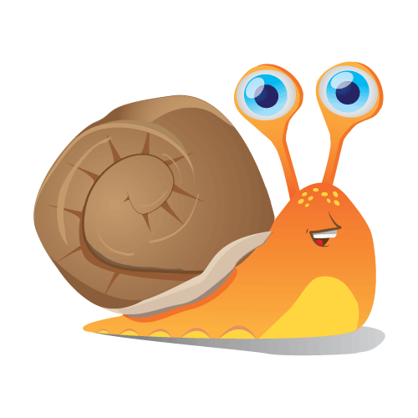
What happens when we have a percentage/probability but don’t know the data value?
For example:
Suppose we have a population of adult snails where the length of a snail shell, X mm, is normally distributed with a mean 23.6, and standard deviation 3.1mm.
What is the shell length that is longer than 95% of the data?

Slide 4
We use the invNorm option on the TI-calculator.
InvNorm always measures percentages from the left of the graph.

Slide 5
A university professor determines that 80% of this year’s History candidates should pass the final examination. The examination results are expected to be normally distributed with a mean of 62 and a standard deviation of 13. Find the lowest score necessary to pass the examination.

