Slide 1
Probability Lesson 3
Bell Ringer
Heinrik rolls two 6-sided dice at the same time. One die has three red sides and three black sides. The other die has the sides numbered from 1 to 6. By means of a tree diagram, table of outcomes or otherwise, answer each of the following questions.
How many different possible combinations can he roll?
What is the probability that he will roll a red and an even number?
What is the probability that he will roll a red or black and a 5?
(d)What is the probability that he will roll a number less than 3?
Independent vs. Dependent events

Slide 2
Learning intentions:
Today I will learn to…
Calculate the probability of independent events.
Calculate the probability of dependent events.
Success Criteria:
I will know I am successful when I can…
Solve IB level problems, such as those in the homework, involving independent and dependent events.
Approaches to Learning:
Research Skills
Thinking Skills

Slide 3
TERMS and NOTATION

Slide 4
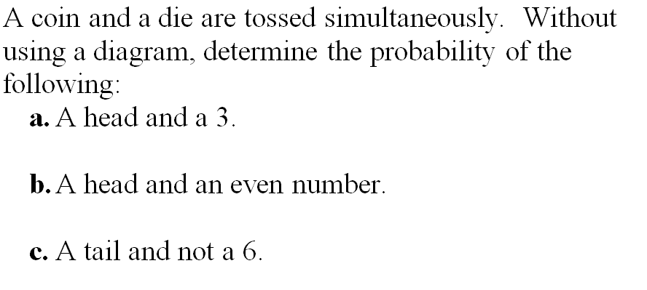

Slide 5
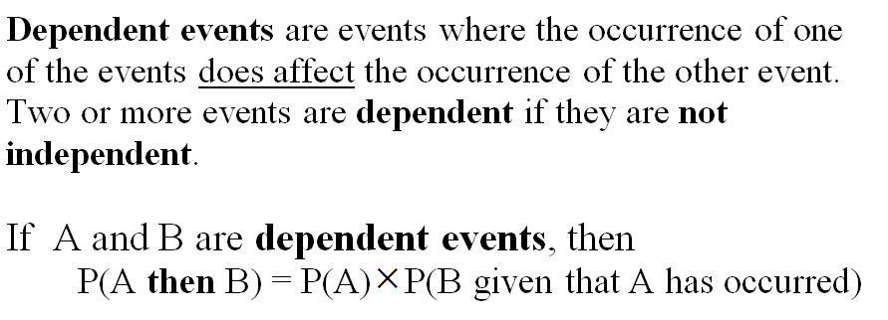
TERMS and NOTATION

