Slide 1
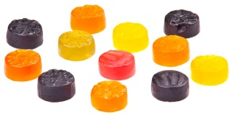
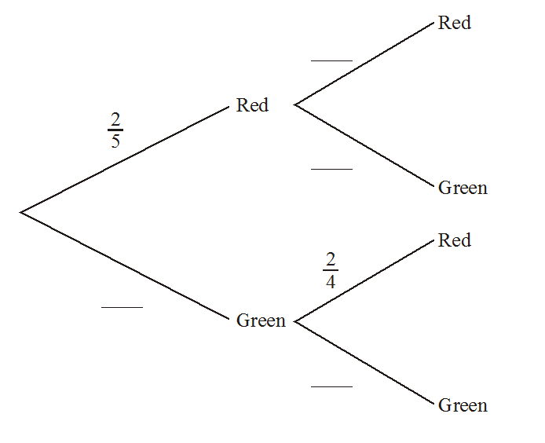
Probability Lesson 4: Non-Equally Likely Events
A bag contains two red sweets and three green sweets. Jacques takes one sweet from the bag, notes its color, then eats it. He then takes another sweet from the bag. Complete the tree diagram below to show all probabilities.

Slide 2
Learning intentions:
Today I will learn to…
Use tree diagrams for non-equally likely events.
Calculate the probability of events with and without replacement.
Success Criteria:
I will know I am successful when I can…
Identify how “replacement” affects the probability of events.
Approaches to Learning:
Thinking Skills
Communication Skills

Slide 3
Terms and Notation
Sampling with and without replacement:
The object is either put back (sampling with replacement) or put aside (sampling without replacement).

Slide 4
A box contains 4 red, 3 blue and 2 white marbles. Two marbles are selected.
Make two tree diagrams: one with replacement, and one without.
Find the probability of getting two different colors
with replacement
without

