Slide 1
Probability Lesson 5: Venn Diagrams
A man holds two tickets in a 100-ticket raffle in which there are two prizes. What is the probability that he will win:
Both Prizes
Neither Prize
At least one prize
IB Mathematical Studies SL Standard
5.5
Use of Venn diagrams, tree diagrams and tables of outcomes.

Slide 2
Learning intentions:
Today I will learn to…
Create Venn diagrams to represent a set of data.
Success Criteria:
I will know I am successful when I can…
Use Venn diagrams to calculate probabilities.
Approaches to Learning:
Thinking Skills
Communication Skills

Slide 3
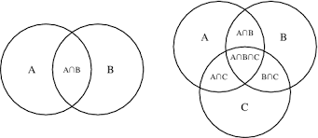
Launch:
Terms and Notation:
What are Venn Diagrams?
Venn Diagrams are a diagram representing mathematical or logical sets pictorially as circles or closed curves within an enclosing rectangle (the universal set), common elements of the sets being represented by the areas of overlap among the circles.

Slide 4
Construct a Venn Diagram that shows that of the 41 students in my first block class, there were 35 people wearing shorts, 10 people wearing flip flops, and 6 people that were wearing both.

