Slide 1
Probability Lesson 7: Mutually Exclusive Events
Bell Ringer
Bin A contains 3 red and 2 white tickets. Bin B contains 4 red and 1 white tickets. A die with 4 faces marked A and two faces marked B is rolled and used to select bin A or B. A ticket is then selected from this bin. Determine the probability that:
a.)The ticket is from bin A and is white.
b.)The ticket is white.
c.)The ticket is chosen from bin A given that it is white.
d.)The ticket is white given that it chosen from bin A.
I.B. Standard

Slide 2
Learning intentions:
Today I will learn to…
Define Mutually Exclusive Events.
Define and use probability laws.
Success Criteria:
I will know I am successful when I can…
Identify the correct probability law(s) to solve a variety of probability problems.
Approaches to Learning:
Thinking Skills
Communication Skills

Slide 3
Terms and Notation:
Mutually Exclusive Events: events that cannot happen at the same time.

Slide 4
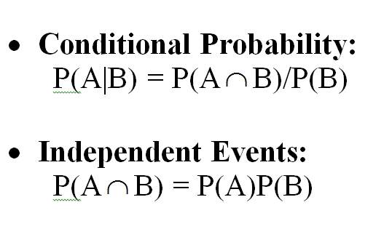

Slide 5
