Slide 1
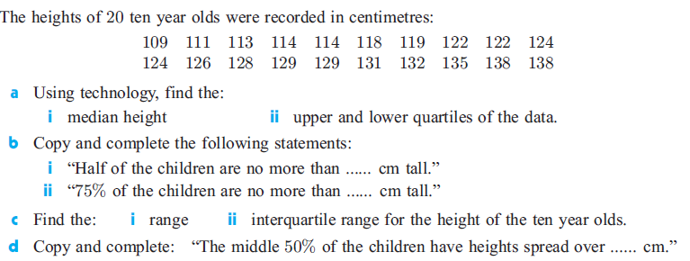
Statistics Lesson 6: Box Plots
Bell Ringer
I.B. Standard
2.4 Box-and-whisker diagram.

Slide 2
Learning intentions:
Today I will learn to…
Create box and whisker plots.
Calculate upper and lower bounds of discrete data to find outliers.
Success Criteria:
I will know I am successful when I can…
Interpret discrete data represented with a box and whisker plot.
Success Criteria:
Communication Skills

Slide 3
Terms and Notation:
A box-and-whisker plot (or boxplot) is a visual display of the five-number-summary of a set of data:
The minimum value (min)
The lower quartile (Q₁)
The Median (Q₂)
The upper quartile (Q₃)
The maximum value (max)

Slide 4
Terms and Notation:
Outliers are extraordinary data that are usually separated from the main body of the data. They are either much larger or much smaller than most of the data.
A commonly used test involves the calculation of boundaries:
The upper boundary = Q₃ + 1.5(IQR). Any data larger than the upper boundary is an outlier.
The lower boundary = Q₁ – 1.5(IQR). Any data smaller than the lower boundary is an outlier.
Outliers are marked with an asterisk on a boxplot, and it is possible to have more than one at either end. The whiskers extend to the last value that is not an outlier.

Slide 5
Given the data below:
1, 3, 7, 4, 3, 6, 5, 8, 1, 5, 6, 3, 6, 4, 3, 11, 15, 2, 4, 8
Find the five-number summary.
Find the upper and lower bounds.
Identify any outliers.
Create a boxplot.

