Slide 1
Statistics Lesson 3: Mean, Median, and Mode
A botanist takes a random sample of six month old seedlings from her nursery and measures their heights. The results are shown in the table:
Represent the data on a frequency histogram.
What percentage of seedlings are between 350 and 400 mm?
Height (h mm) | Frequency
300 ≤ h < 325 | 12
325 ≤ h < 350 | 18
350 ≤ h < 375 | 42
375 ≤ h < 400 | 28
400 ≤ h < 425 | 14
425 ≤ h < 450 | 6
IB Standard
Measures of central tendency. For simple discrete data: mean; median; mode.
For grouped discrete and continuous data: estimate of a mean; modal class.

Slide 2
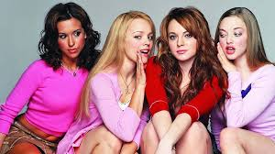
Learning intentions:
Today I will learn to…
Define mean, median and mode.
Success Criteria:
I will know I am successful when I can…
Use mean, median and mode to find central tendencies of data.

Slide 3
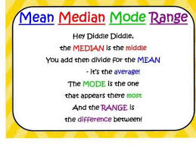
Terms and Notation:
Mean: the arithmetic average obtained by adding all the scores and dividing by the total number (frequency) of scores.
Modes: the score(s) which occur most frequently.
Median: the middle score after all scores have been placed in order of size from smallest to largest.

Slide 4
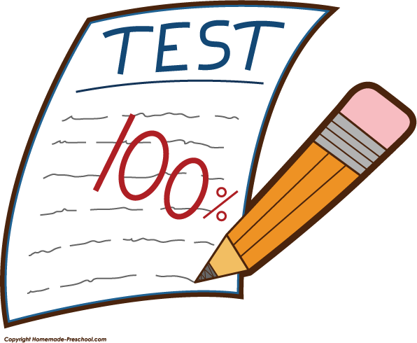
I tested out a point system for grading where there were 8 total points possible on an evidence. I graded a couple of sections in this manner and the results were:
Points Earned | Frequency
0 | 5
1 | 8
2 | 8
3 | 15
4 | 20
5 | 25
6 | 32
7 | 7
8 | 14
What was the mean, median, and mode of the points earned?
How should I determine what amount of points earns a MI, BA, PR, or AD?

