Slide 1
Statistics Lesson 4: Mean, Median, and Mode WITH Technology
A soccer fan decided to record the number of goals their favorite club scored in each of their games. The results were:
Find the cumulative frequency
Find the mean, median, and mode goals scored.
Goals | Frequency
0 1 2 3 4 5 6 7 8 | 5 7 7 8 0 7 9 6 1
I.B. Standard
2.5 Measures of central tendency. For simple discrete data: mean; median; mode

Slide 2
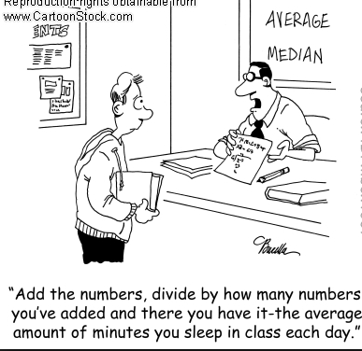
Learning intentions:
Today I will learn to…
Use technology to find mean, median and mode.
Estimate the mean of grouped continuous data.
Success Criteria:
I will know I am successful when I can…
Efficiently and effectively find the central tendency of data.
Learning intentions:
Thinking Skills

Slide 3
Find the mean median and mode of the following data using technology:
A local DNR officer was responsible for recording the number of fish caught in nets for populations estimates.
# of fish | frequency
3 4 5 6 7 8 9 10 11 12 | 5 6 10 4 3 6 13 22 9 15

Slide 4
Terms and Notation:
When continuous data is grouped in classes, we use the midpoint of the class to represent all scores within the interval.
The midpoint of a class interval is the average (mean) of its endpoints.
Any data calculated using the midpoint is an approximation of the true value.
The mode of continuous grouped data is the modal class (the class which occurs most frequently).

Slide 5
Given are the final exam scores for 3 of Mr. Peacock’s Math Studies II classes. Approximate the mean and find the modal class.
score | frequency | Mid-Point Value
0 – < 10 10 – < 20 20 – < 30 30 – < 40 40 – < 50 50 – < 60 60 – < 70 70 – < 80 80 – < 90 90 – < 100 | 2 3 0 4 6 8 17 11 8 5

