Slide 1
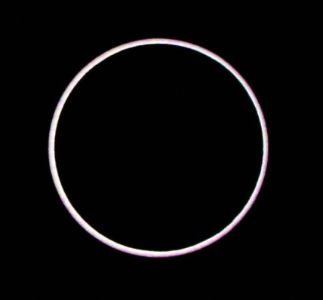
Statistics Lesson 7:Standard Deviation and Variance
Given the data below regarding the amount of minutes spent watching the lunar eclipse:
12, 5, 17, 14, 28, 21, 16, 15, 11, 10, 23, 2, 18
Find the five-number summary.
Find the upper and lower bounds.
Identify any outliers.
Create a boxplot.
I.B. Standard
2.6 Measures of dispersion: range, interquartile range, standard deviation.

Slide 2
Learning intentions:
Today I will learn to…
Define standard deviation and variance.
Success Criteria:
I will know I am successful when I can…
Use technology to find standard deviation variance and other measure of dispersion.
Approaches to Learning:
Research Skills

Slide 3
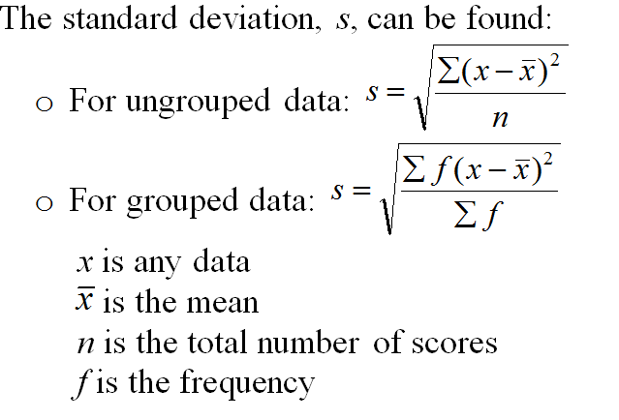
Terms and Notation: Dispersion
Dispersion is the measure of the spread of a data.
Range is a measure of dispersion found by subtracting the maximum and minimum values (max – min).
Standard Deviation measures the deviation between scores and the mean.
The larger the standard deviation, the more widely data is spread. Standard deviation provides a better measure of the spread than range or IQR because it considers all scores in the data.

Slide 4
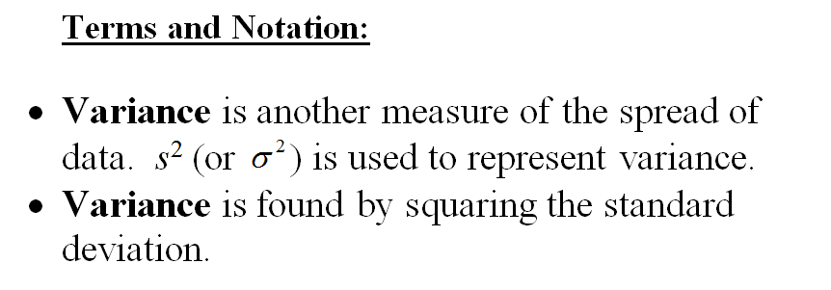

Slide 5
Given the data below of the number of sick days taken by 8 employees last year at a small business:
3, 3, 5, 7, 10, 15, 9, 10
Calculate the standard deviation.
A vaction day will be awarded to emplyees who have taken one standards deviation less than the mean amount of sick days taken last year.

